Slide 1
Python Overview
What is Python?
While you may know the python as a large snake, the name of the Python programming language comes from an old BBC television comedy sketch series called Monty Python’s Flying Circus.
At the height of its success, the Monty Python team were performing their sketches to live audiences across the world, including at the Hollywood Bowl.
Since Monty Python is considered one of the two fundamental nutrients to a programmer (the other being pizza), Python’s creator named the language in honor of the TV show.

Slide 2
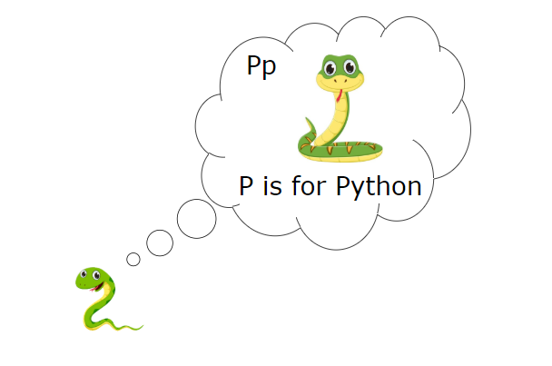

Slide 3
Who created Python? One of the amazing features of Python is the fact that it is actually one person’s work. Usually, new programming languages are developed and published by large companies employing lots of professionals, and due to copyright rules, it is very hard to name any of the people involved in the project. Python is an exception. Python was created by Guido van Rossum, born in 1956 in Haarlem, the Netherlands. Of course, van Rossum did not develop and evolve all the Python components himself.

Slide 4
The speed with which Python has spread around the world is a result of the continuous work of thousands (very often anonymous) programmers, testers, users (many of them aren’t IT specialists) and enthusiasts, but it must be said that the very first idea (the seed from which Python sprouted) came to one head – Guido’s. The circumstances in which Python was created are a bit puzzling. According to van Rossum:

Slide 5
In December 1989, I was looking for a “hobby” programming project that would keep me occupied during the week around Christmas. My office (...) would be closed, but I had a home computer, and not much else on my hands. I decided to write an interpreter for the new scripting language I had been thinking about lately: a descendant of ABC that would appeal to Unix/C hackers. I chose Python as a working title for the project, being in a slightly irreverent mood (and a big fan of Monty Python’s Flying Circus).

Slide 6
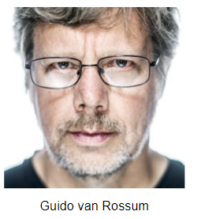

Slide 7
Objective of Python programming creation. In 1999, Guido van Rossum defined his goals for Python: 1) an easy and intuitive language just as powerful as those of the major competitors; 2) open source, so anyone can contribute to its development; 3) code that is as understandable as plain English; 4) suitable for everyday tasks, allowing for short development times.

Slide 8
Either way, it still occupies a high rank in the top ten of the TIOBE Programming Community Index. Python isn’t a young language. It is mature and trustworthy. It’s not a one-hit wonder. It’s a bright star in the programming firmament, and time spent learning Python is a very good investment.

Slide 9
Application Of Python
Where can we see Python in action?
We see it every day and almost everywhere.
It’s used extensively to implement complex Internet services like search engines, cloud storage and tools, social media and so on. Whenever you use any of these services, you are actually very close to Python, although you wouldn’t know it.
Many developing tools are implemented in Python.
More and more everyday use applications are being written in Python. Lots of scientists have abandoned expensive proprietary tools and switched to Python.

Slide 10
Lots of IT project testers have started using Python to carry out repeatable test procedures. The list is long.
Despite Python’s growing popularity, there are still some niches where Python is absent, or is rarely seen:
low-level programming (sometimes called “close to metal” programming): if you want to implement an extremely effective driver or graphical engine, you wouldn’t use Python;
applications for mobile devices: although this territory is still waiting to be conquered by Python, it will most likely happen someday.

Slide 11
Different Python flavors
Cython:
Cython is one of a possible number of solutions to the most painful of Python’s trait – the lack of efficiency. Large and complex mathematical calculations may be easily coded in Python (much easier than in “C” or any other traditional language), but the resulting code’s execution may be extremely time-consuming.
How are these two contradictions reconciled?

Slide 12
One solution is to write your mathematical ideas using Python, and when you’re absolutely sure that your code is correct and produces valid results, you can translate it into “C”.
Certainly, “C” will run much faster than pure Python.
This is what Cython is intended to do – to automatically translate the Python code (clean and clear, but not too swift) into “C” code (complicated and talkative, but agile)

Slide 13
Jython:
“J” is for “Java”.
Imagine a Python written in Java instead of “C”. This is useful, for example, if you develop large and complex systems written entirely in Java and want to add some Python flexibility to them. The traditional CPython may be difficult to integrate into such an environment, as “C” and Java live in completely different worlds and don’t share many common ideas.
Jython can communicate with existing Java infrastructure more effectively. This is why some projects find it usable and needful.
Note: the current Jython implementation follows Python 2 standards. There is no Jython conforming to Python 3, so far.

Slide 14
PyPy:
In other words, it represents a Python environment written in Python-like language named RPython (Restricted Python). It is actually a subset of Python. The source code of PyPy is not run in the interpretation manner, but is instead translated into the “C” programming language and then executed separately.
This is useful because if you want to test any new feature that may be (but doesn’t have to be) introduced into mainstream Python implementation, it’s easier to check it with PyPy than with CPython. This is why PyPy is rather a tool for people developing Python than for the rest of the users.

Slide 15
Programming Basics
How does a computer program work?
A program makes a computer usable. Without a program, a computer, even the most powerful one, is nothing more than an object. Similarly, without a player, a piano is nothing more than a wooden box.
Computers are able to perform very complex tasks, but this ability is not innate. A computer’s nature is quite different.

Slide 16
It can execute only extremely simple operations, e.g., a computer cannot evaluate the value of a complicated mathematical function by itself, although this isn’t beyond the realms of possibility in the near future.
Contemporary computers can only evaluate the results of very fundamental operations, like adding or dividing, but they can do it very fast, and can repeat these actions virtually any number of times

Slide 17
Natural languages vs. programming languages
A language is a means (and a tool) for expressing and recording thoughts. There are many languages all around us. Some of them require neither speaking nor writing, such as body language; it’s possible to express your deepest feelings very precisely without saying a word.
Another language you use each day is your mother tongue, which you use to manifest your will and to think about reality. Computers have their own language, too, called machine language, which is very rudimentary.

Slide 18
The commands it recognizes are very simple. We can imagine that the computer responds to orders like “take that number, divide by another and save the result”.
A complete set of known commands is called an instruction list, sometimes abbreviated to IL. Different types of computers may vary depending on the size of their ILs, and the instructions could be completely different in different models.
Note: machine languages are developed by humans.

Slide 19
On the other hand, people use a number of very different languages, too, but these languages created themselves. Moreover, they are still evolving.
New words are created every day and old words disappear. These languages are called natural languages.

Slide 20
What makes a language?
We can say that each language (machine or natural, it doesn’t matter) consists of the following elements:
an alphabet: a set of symbols used to build words of a certain language (e.g., the Latin alphabet for English, the Cyrillic alphabet for Russian, Kanji for Japanese, and so on)
a lexis aka a dictionary: a set of words the language offers its users (e.g., the word “computer” comes from the English language dictionary, while “cmoptrue” doesn’t; the word “chat” is present both in English and French dictionaries, but their meanings are different)
a syntax: a set of rules (formal or informal, written or felt intuitively) used to determine if a certain string of words forms a valid sentence (e.g., “I am a python” is a syntactically correct phrase, while “I a python am” isn’t)
semantics: a set of rules determining if a certain phrase makes sense (e.g., “I ate a doughnut” makes sense, but “A doughnut ate me” doesn’t)

Slide 21
Compilation vs. interpretation
Computer programming is the act of composing the selected programming language’s elements in the order that will cause the desired effect. The effect could be different in every specific case – it’s up to the programmer’s imagination, knowledge and experience.
Of course, such a composition has to be correct in many senses:
alphabetically – a program needs to be written in a recognizable script, such as Roman, Cyrillic, etc.
lexically – each programming language has its dictionary and you need to master it; thankfully, it’s much simpler and smaller than the dictionary of any natural language;
syntactically – each language has its rules and they must be obeyed;
semantically – the program has to make sense.

Slide 22
There are two different ways of transforming a program from a high-level programming language into machine language:
compilation – the source program is translated once (however, this act must be repeated each time you modify the source code) by getting a file (e.g., an .exe file if the code is intended to be run under MS Windows) containing the machine code; now you can distribute the file worldwide; the program that performs this translation is called a compiler or translator;
interpretation – you (or any user of the code) can translate the source program each time it has to be run; the program performing this kind of transformation is called an interpreter, as it interprets the code every time it is intended to be executed; it also means that you cannot just distribute the source code as-is, because the end-user also needs the interpreter to execute it.

Slide 23


Scripting Languages:
Programming Languages:

Slide 24
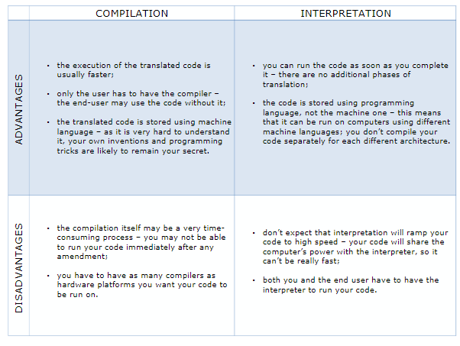

Slide 25
How to get Python and how to get to use it
There are several ways to get your own copy of Python 3, depending on the operating system you use.
Linux users most probably have Python already installed – this is the most likely scenario, as Python’s infrastructure is intensively used by many Linux OS components.

Slide 26
If you’re a Linux user, open the terminal/console, and type:
python3
at the shell prompt, press Enter and wait. If you see something like this:
Python 3.4.5 (default, Jan 12 2017, 02:28:40) [GCC 4.2.1 Compatible Clang 3.7.1 (tags/RELEASE_371/final)] on linux Type "help", "copyright", "credits" or "license" for more information. >>>

Slide 27
Windows users can download a specific version of Python from below link.
https://www.python.org/
Windows users can download community version of pycharm from below link.
https://www.jetbrains.com/pycharm/download/#section=linux

